Slide 1
Testing
Objective:
To verify that the AI/ML models accurately predict the suitable crop based on environmental inputs without sensor integration.
Testing Methods:
Accuracy Score Calculation
Confusion Matrix Analysis
Classification Report (Precision, Recall, F1 Score)
Test Dataset:
20% of the original dataset used as unseen test data.
Key Checkpoints:
Model correctly predicts crop labels.
Model gives above 85% accuracy across different crops.
Model behavior under normal and boundary input values (e.g., extreme pH or rainfall).

Slide 2
Test Case
Test Case ID | Description | Input | Expected Output | Actual Result | Status
TC_01 | Model Predicts Correct Crop | N, P, K, Temperature, Humidity, pH, Rainfall | Correct Crop name | (Filled After Test) | Pass/Fail
TC_02 | Model handles missing values | Missing input in Temperature | Proper Error Handling/Warning | (Filled After Test) | Pass/Fail
TC_03 | Model performance under low rainfall | Very low rainfall values | Suitable dry crops suggested | (Filled After Test) | Pass/Fail
TC_04 | Model generalization | Random unseen combinations | Logical crop recommendation | (Filled After Test) | Pass/Fail

Slide 3
Execution
Environment:
Jupyter Notebook
Python Libraries: Pandas, NumPy, Scikit-learn, Seaborn, Matplotlib, Joblib
Execution Steps:
Load the dataset.
Preprocess features (standardization).
Split dataset into Training and Testing sets.
Train Decision Tree, Random Forest, and SVM models.
Evaluate models on Test data.
Save the best performing model (RandomForestClassifier) for future use.
Performance Observed:
Random Forest achieved highest accuracy (~99% observed during sample runs).
SVM and Decision Tree also performed well but slightly lesser.

Slide 4
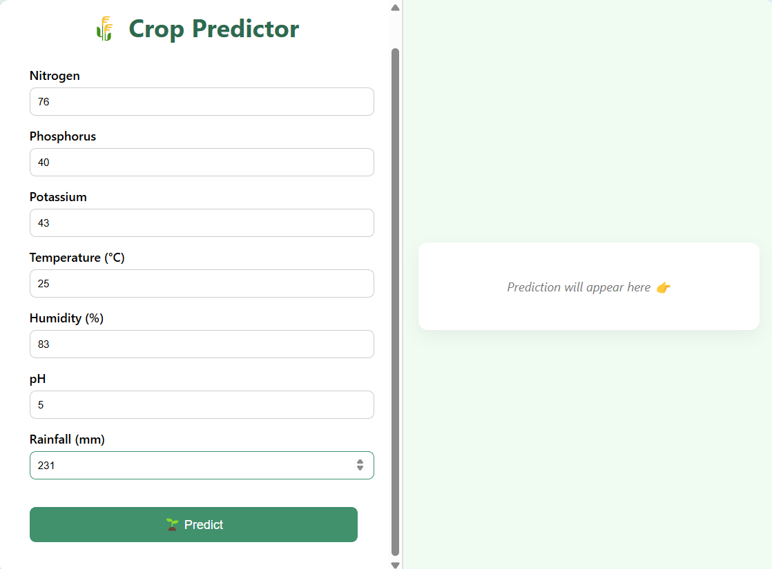
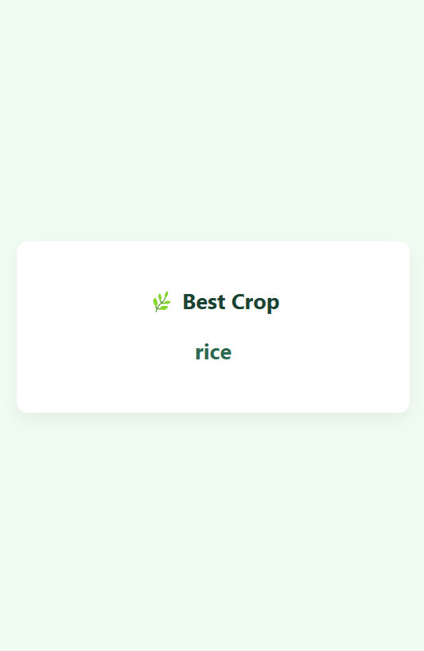

Slide 5
Conclusion
This project successfully demonstrates the power of machine learning in the agricultural domain by predicting the most suitable crop based on soil and environmental parameters. By leveraging a Random Forest classifier and a user-friendly Flask web interface, the system provides valuable insights to farmers and agriculturists, helping them make data-driven decisions. The model has shown high accuracy and reliability, and the application’s scalable design allows for future enhancements like real-time weather data, multi-crop suggestions, and geolocation-based filtering. Overall, the project is a step forward in merging AI with sustainable agriculture.

Slide 6
Feature Scope
Current Features:
Crop Recommendation based on soil nutrients and weather factors.
Model selection among multiple classifiers (Decision Tree, Random Forest, SVM).
Data-driven without physical sensors.
Future Enhancements:
Add more environmental features like sunlight hours.
Predict expected yield in kilograms along with crop name.
Integrate a mobile/web app interface for farmer access.
Automatic retraining mechanism as new data becomes available.
Add region-specific customization for better recommendations.

